Slide 1
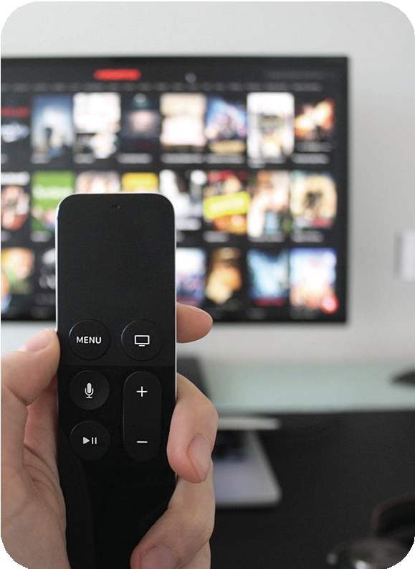
Personal Injury Case Study
CASE STUDY GOAL: Regional Personal Injury Law Firm was looking to drive traffic to their website, brand recognition, phone calls and driving new cases at scale. SOLUTION: ConsulTV suggested a three-month test campaign that targeted individuals in the DMA utilizing Connected TV, Online Video (OLV), along with Site Retargeting using Online Video (OLV). TARGETING: Targeting Provided by client based on their typical client: Zip Codes provided by client, 21 – 65 years old, and HH income under $90k was the targeting provided. MEDIA: Premium Connected TV was deployed with 1,150,000 CTV spots per month, and 350,000 Online Video Spots per month with retargeting. RESULTS: Law Firm Averaged over 11 calls per day, for a monthly average of 305, using call tracking on the CTV ads. Also, they saw a lift of over 1150 clicks to the website per month, using an attribution pixel for CTV and clicks from Online Video (OLV). Estimated calls from website were approx. 5% per month using the clients normal site conversion data.
TREND:
Cable Bleeding Subscribers
In year 2024 TV HH that have cancelled cable or never had cable will exceed cable homes
More HH today have CTV then a cable box (1)
Unique reach is important in streaming
*1. Truoptic LLC, MediaAd Biz 2/20/20

