Slide 1
MANAGED NETWORKS

Slide 2
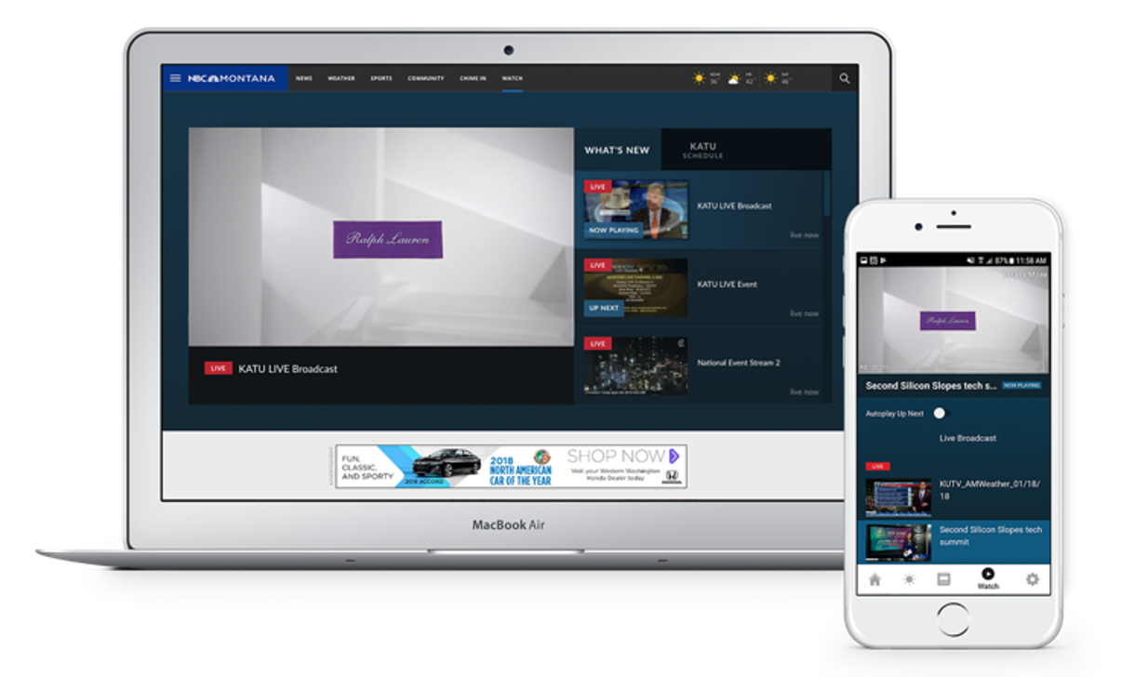
ONLINE VIDEO (OLV)
Non-Skippable Video Advertising
Align your brand with top-quality programming and original video content to grow your audience, resonate with consumers and drive engagement.
For increased impact and brand awareness, video pre- and mid-roll solutions are available on all Live and VOD video content omni-platform.
With average completion rates greater than 55%, this opportunity allows you to deliver more information about your brand by showing and telling our audience simultaneously.

Slide 3
ONLINE DISPLAY
Managed Networks
Targets sites that index highly for the desired target audience. Examples include Moms, Sports, Entertainment, Travel, etc.
Audience Targeting
Behavioral data to reach highly targeted consumers by demographic, interest, intent, and branded data in audiences. Examples include Females, A18-34 auto intenders.
Site Retargeting
Reaching customers and prospects that have been driven to an advertisers' site and then retarget to them as they surf the web.
Keyword Targeting
Connect with highly-engaged consumers on sites and apps that index high for words and phrases related to a business or service using keywords.
IP Address Targeting
Deliver digital ad messages to specific physical mailing addresses by matching the IP address.
Geofencing Targeting
Deliver digital ad messages to specific physical location geofences

Slide 4
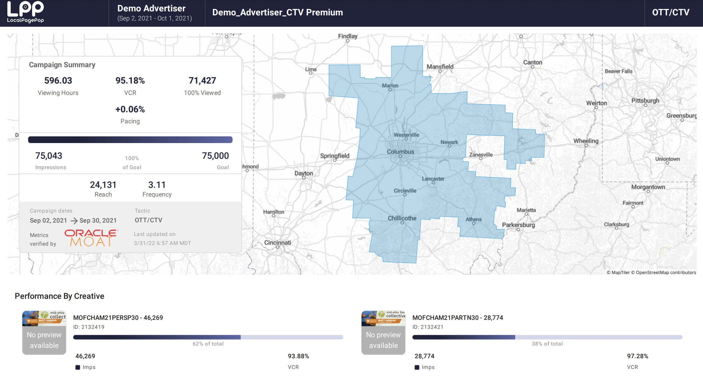
CAMPAIGN REPORTING
Reporting Platform for Updated Data and Transparency on the Campaign Performance
Platform Updates Multiple Times a Day with Data
CTV/OTT Lift Pixel Provided to Track Lift from the TV Spots
Completion Rates for all Video Reported On
Click & Conversion (if applicable) tracking on OLV and Display
Data is 3rd Party Validated by Oracle MOAT
Gold Standard in Industry

Slide 5
PROPOSAL OUTLIINE
Geography: State of Texas
Targeting: Insurance Agents – Property & Casualty
34,731 email addresses of Insurance Agents/Brokers that we have opted-in for owners, partners, CEO, CFO, principal
Cost to deploy email per month: $278
Geofencing using Provided Address Data
Banners & Video Ads
200,000 Banner Ad Impressions
116,667 Video Ad Impressions
$2200 for Banner & Video Ads
Total Cost is $2478/month

