Slide 1
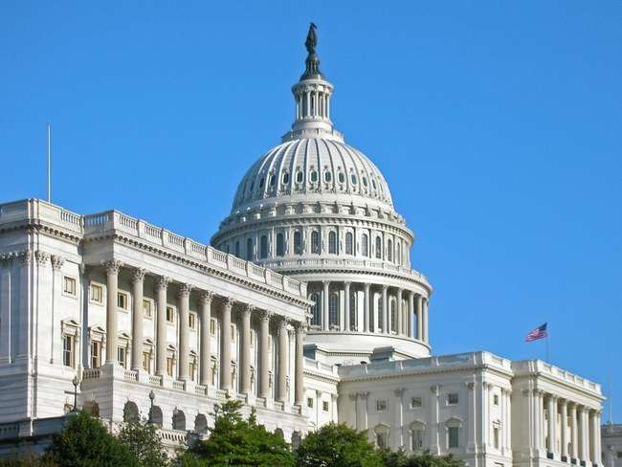
ACTIVATE LOCALLY. Target The Right Voter with the Right Message!

Slide 2
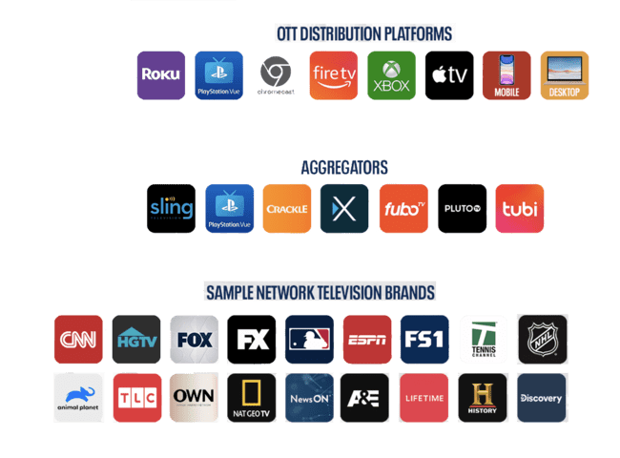
FROM OTT TO DIGITAL EVERYTHING IN BETWEEN, WE HAVE OPTIONS TO REACH VOTERS
We offer choices for any budget on a national, regional, and hyper local level. Let our local news, premium sports, and local sports turn viewers into your voters.

Slide 3
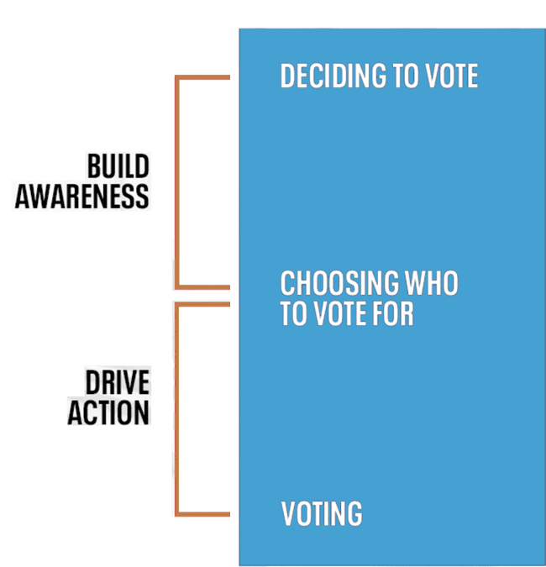
USE A STRATEGY TO REACH VOTERS THROUGH ALL POINTS OF THEIR JOURNEY
THE VOTER JOURNEY HAS MANY TOUCHPOINTS, YOUR POLITICAL STRATEGY SHOULD TOO
TREND:
Cable Bleeding Subscribers
Use a strategy that includes both traditional and digital mediums to reach voters at all points throughout their journey.
BUILD AWARENESS
DRIVE ACTION
In year 2024 TV HH that have cancelled cable or never had cable will exceed cable homes
More HH today have CTV then a cable box (1)
Unique reach is important in streaming
*1. Truoptic LLC, MediaAd Biz 2/20/20

Slide 4
THE POLITICAL ADVERTISING LANDSCAPE MUST INCLUDE DIGITAL TO ENSURE YOUR MESSAGE IS REACHING THOSE UNDECIDED, INFLUENTIAL, AND TARGETED VOTERS
We offer various creative formats and solutions to deliver your message and cultivate trust with voters and meet them where they are in their news journey.
Projected
116% increase
for digital ad spend in 2020
$1.2 billion is projected to be spent on
digital advertising in 2020, accounting for 20% of US political ad spending
65%
43%
of US adults turn to digital
channels to gather information
about the election
of US registered voters search for more information about a candidate after viewing a digital advertisement

Slide 5
PREPARE FOR IMPACT! THE MORE ADVERTISING FORMATS YOU USE, THE MORE VOTERS YOU WILL INEVITABLY REACH - ESPECIALLY THOSE UNDECIDED VOTERS
A multi-platform, Omni-channel campaign allows you to engage with users and reinforce your message, who you are, what you stand for and deliver that message in all the right places.

Slide 6
COMMUNICATE YOUR PLATFORM ON OUR PLATFORM
The combined power of multiscreen TV further strengthens the influence that TV has among undecided voters. Work with ConsulTV Integrated Marketing to customize Digital and OTT solutions:
Online Video – Mobile & Desktop
OTT & CTV
Streaming Audio
IP Targeting
Premium OLV and Banner Advertising
Native Advertising
Enhanced Email
Podcasts and Streaming Audio

Slide 7
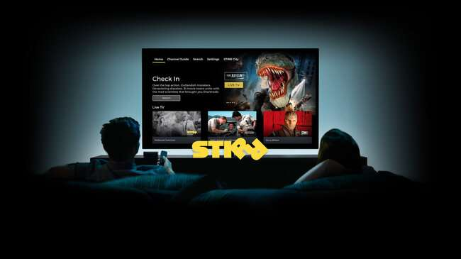
OTT IS THE FASTEST GROWING SEGMENT IN THE AD-SUPPORTED MEDIA MARKETPLACE FOR POLITICAL CAMPAIGNS
TREND:
Cable Bleeding Subscribers
Our OTT advertising opportunity offers you a new and modern way to reach and speak to a growing segment of voters. OTT viewers are not channel-surfers, they are highly engaged and self-select their programming.
Deliver your message to this high-value target audience as they make decisions about issues that matter most to them throughout the election journey.
OTT ad market is the fastest growing segment of the ad marketplace, increasing by 54% in 2018, and another 39% in 2019
Political advertising on OTT grew 200% in 2018 from 2016
OTT allows for campaigns to reach young voters- the largest segment of OTT is 25-34
In year 2024 TV HH that have cancelled cable or never had cable will exceed cable homes
More HH today have CTV then a cable box (1)
Unique reach is important in streaming
*1. Truoptic LLC, MediaAd Biz 2/20/20

Slide 8
WHAT IS OTT?
FEATURES
Creative length :15 & :30
Nielsen DMA’s - All 210
Currency: Impression CPM
95%+ target VCR rate
80%+ target on CTV device
Creative change out under 48 hrs
0% Non-subscription inventory

Slide 9
WHY OTT VIEWING FOR POLITICAL
OTT is for any advertiser or ad agency that is finding it difficult to reach over-the-top viewers. OTT is an advanced video ad delivery platform that enables advertisers in local DMA’s to target viewers of OTT television programming though reputable and validated data targeting sets.
200
Million
80%
71%
41%
OF ALL US HH USE OTT 1X/MONTH
SHARE OF ALL VIDEO DELIVERY
OTT & CTV USERS
OF ALL LONG-FORM STREAMING ON A TELEVISION
*1. Truoptik Ad Suite 2020 , Page 4, Leichman Research *2. Nielsen/Comscore, TruOptik Ad Guid. *3. eMarketer, July 2019
4. Marketing Research FirmPiplsay

Slide 10
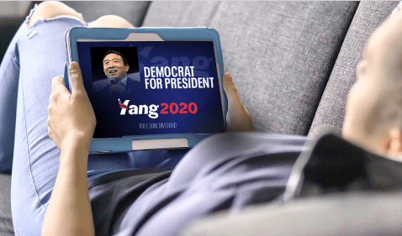
OTT TARGETS THE CORD-CUTTERS WITH TARGETED POLITICAL MESSAGE
TREND:
Cable Bleeding Subscribers
Reaches any zip code or DMA in the U.S.
Over 100 political data targeting segments
Can target with different creative to different groups
Daily dashboard live reporting
Massive scale and breadth of publishers
Takeaway: Our OTT is a leading OTT/CTV platform utilizing data to target your voters
In year 2024 TV HH that have cancelled cable or never had cable will exceed cable homes
More HH today have CTV then a cable box (1)
Unique reach is important in streaming
*1. Truoptic LLC, MediaAd Biz 2/20/20

Slide 11
VIDEO IS THE MOST EFFECTIVE WAY TO SPEAK DIRECTLY TO YOUR TARGET AUDIENCE AND COMPEL THEM TO MAKE A DECISION
Users turn to our VOD, Live and Linear Video content to consume news all day long.
Our cross-device video advertising solution allows addressable and highly targeted messages to speak to our engaged users to get donations, support or drive a call to action.
85% of all internet users in the US watch online video content monthly on any of their devices
The average user spends 88% more time on a website with video
Viewers are 95% more likely to remember a call to action after watching a video
47% of Americans prefer to watch the news rather than read or listen to it
Source: https://www.oberlo.com/blog/video-marketing-statistics, https://www.usatoday.com/story/money/media/2018/12/03/most-americans-prefer-watch-news-not-read-study-says/2189310002/

Slide 12
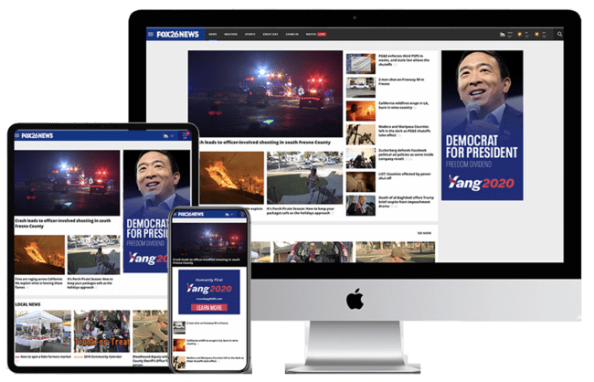
TAILOR YOUR MESSAGE AND SPEAK DIRECTLY TO THE VOTERS USING ADDRESSABLE DISPLAY ADVERTISING
TREND:
Cable Bleeding Subscribers
Target people based on their affiliations, demographics, and behavior utilizing our unprecedented user data. This allows you to test various messages across devices gaining real-time feedback on the messages that resonate best with that user group.
Cross-device display advertising maximizes your reach to deliver a targeted campaign at the lowest cost model.
In year 2024 TV HH that have cancelled cable or never had cable will exceed cable homes
More HH today have CTV then a cable box (1)
Unique reach is important in streaming
*1. Truoptic LLC, MediaAd Biz 2/20/20

Slide 13
WE CAN BE YOUR TURN-KEY DIGITAL POLITICAL AGENCY
OTT & CTV
Social Advertising using data lists
Desktop video
Mobile video
Display advertising
Website design
Email list marketing
Mobile geofencing
Streaming Audio & Podcasts
Takeaway: Your campaign is too important - work with a trusted pro.

Slide 14
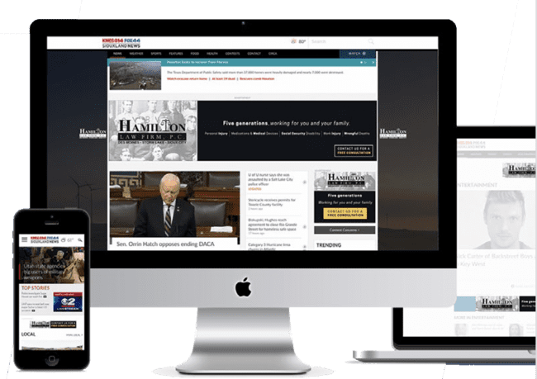
DIGITAL AD CAPABILITIES
TREND:
Cable Bleeding Subscribers
JPEG, PNG, GIF, HTML5
Email HTML
Rich Media with advanced options:
Expandability
Locators
Photo or video galleries
Responsive layout for mobile
Dynamic (rule-based) driven content
Feed based content
In-Banner Video Ads
Sliding Billboard
Wallpaper
In year 2024 TV HH that have cancelled cable or never had cable will exceed cable homes
More HH today have CTV then a cable box (1)
Unique reach is important in streaming
*1. Truoptic LLC, MediaAd Biz 2/20/20

Slide 15
Thank You

