Slide 1
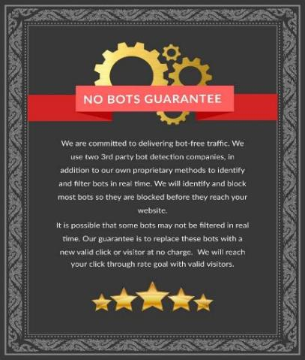
What about BOTS?
FIND . GET . KEEP CUSTOMERS
We are committed to delivering bot-free traffic.
No Bots Guarantee
Benefits:
Ensures that your client’s ads are seen by real people instead of bots and spiders
How it’s done:
We use two third-party bot detection companies, in addition to our own proprietary methods to identify and filter bots in real time.
We will identify and block most bots before they reach the client’s website

