Slide 1
State of TV Viewers
Streaming has been growing in popularity among consumers over the last few years, and this year we have finally seen the tipping point for this channel surpassing linear TV in terms of viewing time.
In July of 2022, streaming viewership passed cable for the first time ever. According to a report from Nielsen, streaming made up 34.8% of all viewing time that month, topping cable’s 34.4% and broadcast’s 21.6%. And that rise in streaming viewership only continued for the rest of the year—reaching 36.2% of all viewing time in September vs. the 33.8% and 24.2% of time that consumers spent with cable and broadcast, respectively. This is despite a 222% increase in sports viewing on broadcast channels around that time.
Share of US Time Spent with TV from Sept 2021-2022
Sept 2021
Dec 2021
June 2021
March 2022
Sept 2022
US Pay vs. Non-Pay TV Viewers
Part of the reason for this drop in viewership on linear has been the rise of cord-cutting. This year, the number of pay TV households dropped significantly—falling 7.2% to 66.4 million households. At this rate, eMarketer expects non-pay TV (cord-cutter and cord-never) households to outnumber Pay-TV households by next year and reach 25 million more households than Pay-TV by 2026.

Slide 2
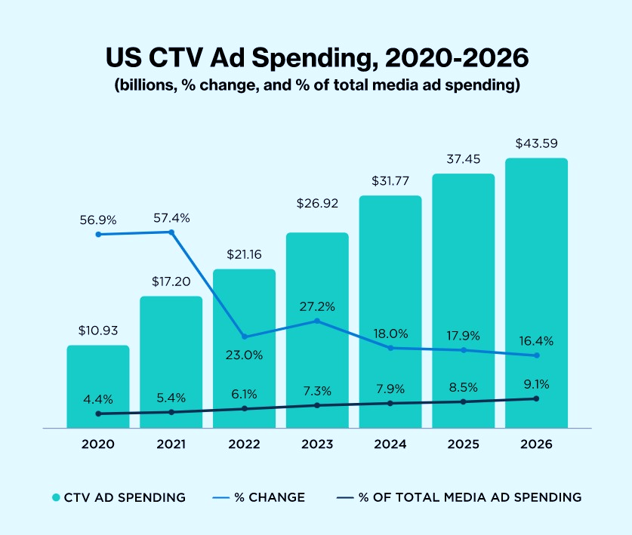
Non-Pay TV Viewers
Pay TV Viewers
It comes as no surprise that so many households have chosen to make that switch from linear to streaming this year. One study from Civic Science found that 63% of cord-cutters did so because they considered cable to be too expensive. With the recent economic turmoil, many households can’t justify spending an average of $1,618 a year for cable TV channels they don’t watch.
What About TV Advertisers?
Why are they slow to Change?
Advertisers have also been increasing their investment in Connected TV ads. eMarketer estimates that US CTV ad spend will exceed $21 billion this year—reaching $43.59 billion by 2026. The source raised their estimates in October due to the number of streaming services that added ad-supported tiers this year, and the news that mid-tier streaming services had more ad growth than expected.
US CTV Ad Spending, 2020-2026
$

